Slide 1
Exploratory Data Analysis (EDA) for Real Estate Pricing: Unveiling the Dynamics of House Valuation in a Dynamic Market
Project_3
Github link:- https://github.com/PrakashPatel8979/Project-3

Slide 2
Import Library
import pandas as pd
import numpy as np
import matplotlib.pyplot as plt
import seaborn as sns
sns.set(style="whitegrid")
df = pd.read_csv("housing_data.csv")
df.head()

Slide 3
Cleaning the Data:
# Check missing values
missing_values = df.isnull().sum().sort_values(ascending=False)
missing_values = missing_values[missing_values > 0]
print("Missing values:\n", missing_values)
# Drop columns with more than 50% missing values
threshold = len(df) * 0.5
df_cleaned = df.drop(columns=[col for col in missing_values.index if df[col].isnull().sum() > threshold])
# Drop remaining missing values
df_cleaned = df_cleaned.dropna()
# Drop duplicates
df_cleaned = df_cleaned.drop_duplicates()
# Check structure after clea

Slide 4
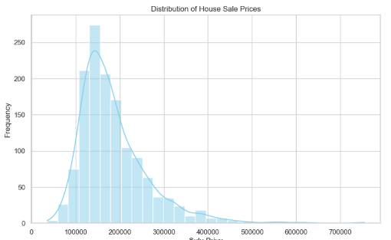
Univariate Analysis:
# 1. Distribution of House Prices
plt.figure(figsize=(10,6))
sns.histplot(df_cleaned['SalePrice'], kde=True, color='skyblue', bins=30)
plt.title('Distribution of House Sale Prices')
plt.xlabel('Sale Price')
plt.ylabel('Frequency')
plt.show()

Slide 5
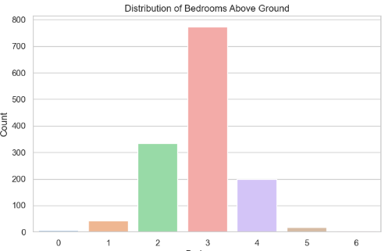
Univariate Analysis:
# 2. Count of Bedrooms Above Ground
plt.figure(figsize=(8,5))
sns.countplot(x='BedroomAbvGr', data=df_cleaned, palette='pastel')
plt.title('Distribution of Bedrooms Above Ground')
plt.xlabel('Bedrooms')
plt.ylabel('Count')
plt.show()

Slide 6
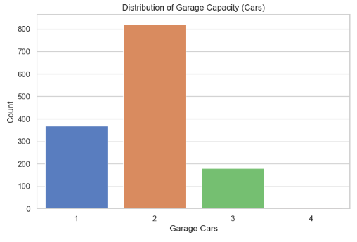
Univariate Analysis:
# 3. Count of Garage Cars
plt.figure(figsize=(8,5))
sns.countplot(x='GarageCars', data=df_cleaned, palette='muted')
plt.title('Distribution of Garage Capacity (Cars)')
plt.xlabel('Garage Cars')
plt.ylabel('Count')
plt.show()

Slide 7
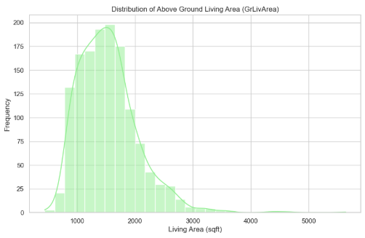
Univariate Analysis:
# 4. Distribution of Living Area
plt.figure(figsize=(10,6))
sns.histplot(df_cleaned['GrLivArea'], kde=True, color='lightgreen', bins=30)
plt.title('Distribution of Above Ground Living Area (GrLivArea)')
plt.xlabel('Living Area (sqft)')
plt.ylabel('Frequency')
plt.show()

Slide 8
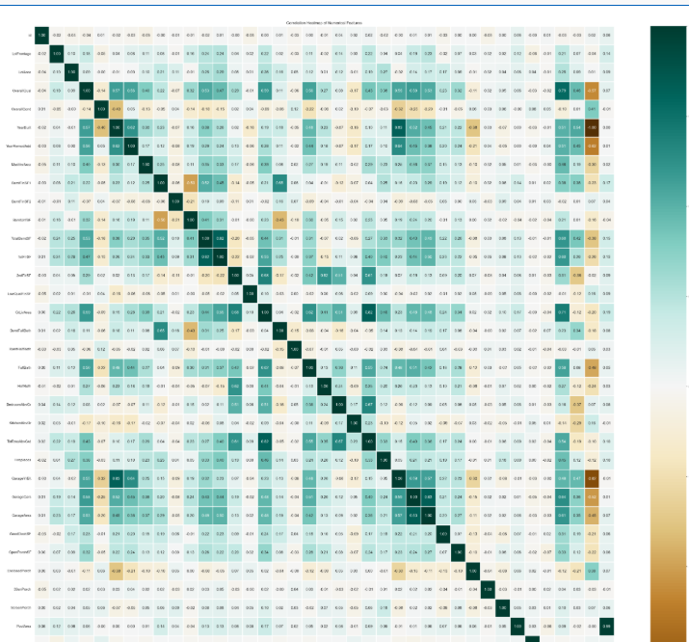
Multivariate Analysis:
# Select only numerical columns
numerical_data = df_cleaned.select_dtypes(include=['number'])
# 1. Correlation Heatmap
plt.figure(figsize=(40,40))
sns.heatmap(numerical_data.corr(), cmap='BrBG', fmt='.2f', linewidths=1, annot=True)
plt.title("Correlation Heatmap of Numerical Features")
plt.show()

Slide 9
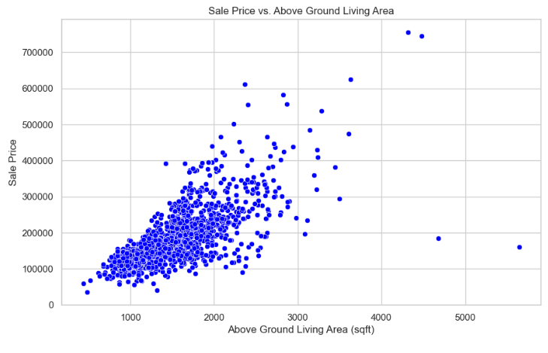
Multivariate Analysis:
# 2. Scatter Plot: GrLivArea vs SalePrice
plt.figure(figsize=(10,6))
sns.scatterplot(x='GrLivArea', y='SalePrice', data=df_cleaned, color='blue')
plt.title('Sale Price vs. Above Ground Living Area')
plt.xlabel('Above Ground Living Area (sqft)')
plt.ylabel('Sale Price')
plt.show()

Slide 10
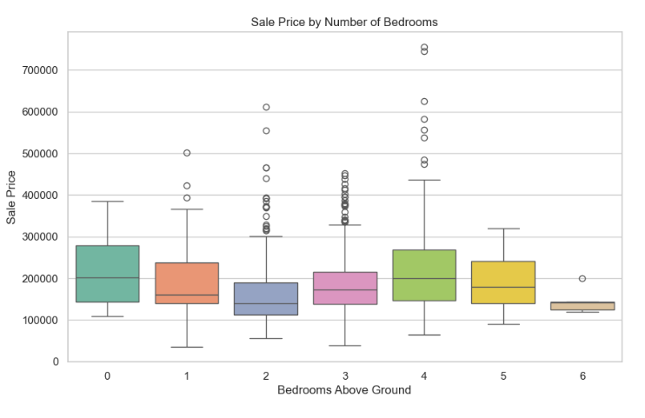
Multivariate Analysis:
# 3. Boxplot: SalePrice vs Bedrooms
plt.figure(figsize=(10,6))
sns.boxplot(x='BedroomAbvGr', y='SalePrice', data=df_cleaned, palette='Set2')
plt.title('Sale Price by Number of Bedrooms')
plt.xlabel('Bedrooms Above Ground')
plt.ylabel('Sale Price')
plt.show()

Slide 11
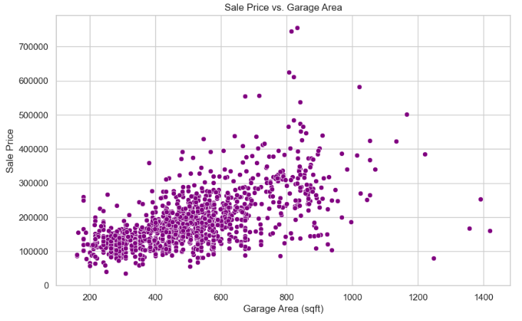
Multivariate Analysis:
# 4. Scatter Plot: GarageArea vs SalePrice
plt.figure(figsize=(10,6))
sns.scatterplot(x='GarageArea', y='SalePrice', data=df_cleaned, color='purple')
plt.title('Sale Price vs. Garage Area')
plt.xlabel('Garage Area (sqft)')
plt.ylabel('Sale Price')
plt.show()

Slide 12
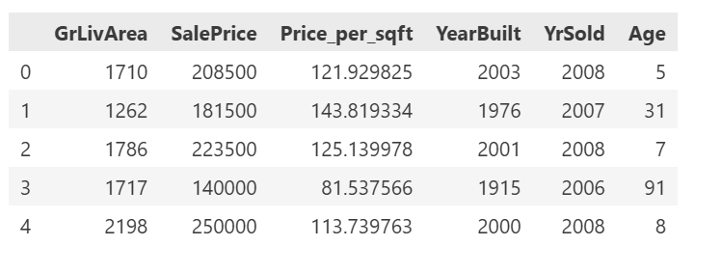
Feature Engineering:
# 1. Price per Square Foot
df_cleaned['Price_per_sqft'] = df_cleaned['SalePrice'] / df_cleaned['GrLivArea']
# 2. House Age
df_cleaned['Age'] = df_cleaned['YrSold'] - df_cleaned['YearBuilt']
# Display the new features
df_cleaned[['GrLivArea', 'SalePrice', 'Price_per_sqft',

Slide 13
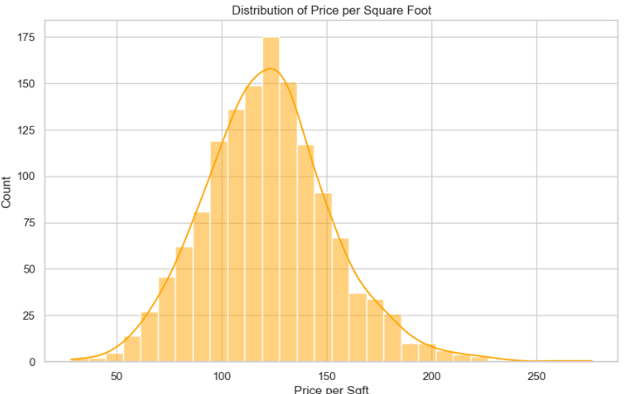
Feature Engineering:
plt.figure(figsize=(10,6))
sns.histplot(df_cleaned['Price_per_sqft'], bins=30, kde=True, color='orange')
plt.title('Distribution of Price per Square Foot')
plt.xlabel('Price per Sqft')
plt.ylabel('Count')
plt.show()

Slide 14
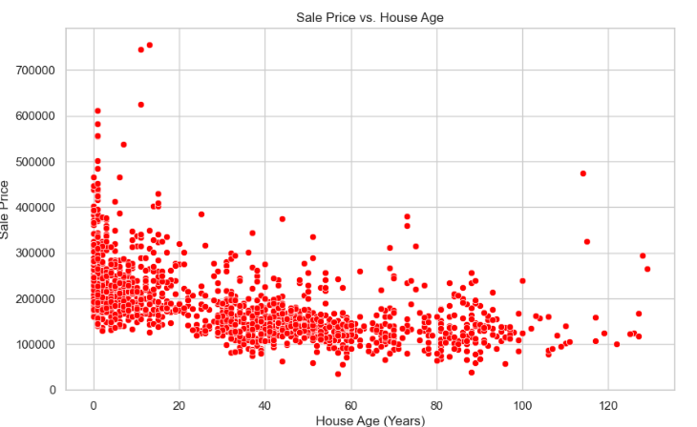
Feature Engineering:
plt.figure(figsize=(10,6))
sns.scatterplot(x='Age', y='SalePrice', data=df_cleaned, color='red')
plt.title('Sale Price vs. House Age')
plt.xlabel('House Age (Years)')
plt.ylabel('Sale Price')
plt.show()

Slide 15
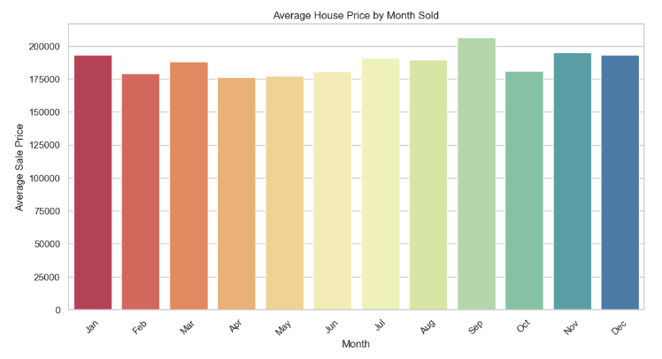
Feature Engineering and Size Impact:
# Optional: Convert month names to numbers for sorting
month_order = ['Jan', 'Feb', 'Mar', 'Apr', 'May', 'Jun',
'Jul', 'Aug', 'Sep', 'Oct', 'Nov', 'Dec']
df_cleaned['MoSold'] = pd.Categorical(df_cleaned['MoSold'], categories=month_order, ordered=True)
# Group by Month
monthly_price = df_cleaned.groupby('MoSold')['SalePrice'].mean().reset_index()
# Bar plot
plt.figure(figsize=(12,6))
sns.barplot(data=monthly_price, x='MoSold', y='SalePrice', palette='Spectral')
plt.title('Average House Price by Month Sold')
plt.xlabel('Month')
plt.ylabel('Average Sale Price')
plt.xticks(rotation=45)
plt.show()

Slide 16
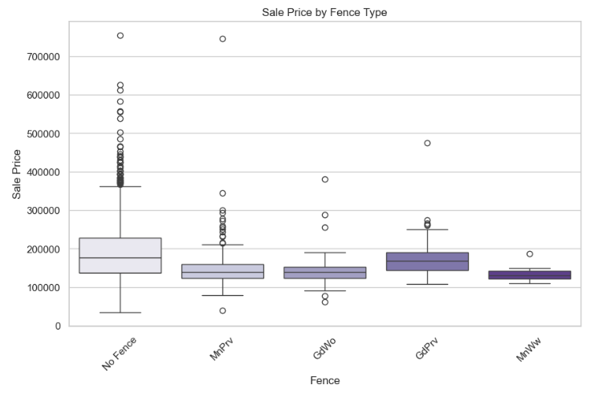
Feature Engineering and Size Impact:
# Replace 'No' and NA with 'No Fence' label
df_cleaned['Fence'] = df_cleaned['Fence'].replace({'No': 'No Fence'}).fillna('No Fence')
# Boxplot of Fence vs SalePrice
plt.figure(figsize=(10,6))
sns.boxplot(x='Fence', y='SalePrice', data=df_cleaned, palette='Purples')
plt.title('Sale Price by Fence Type')
plt.xlabel('Fence')
plt.ylabel('Sale Price')
plt.xticks(rotation=45)
plt.show()

Slide 17
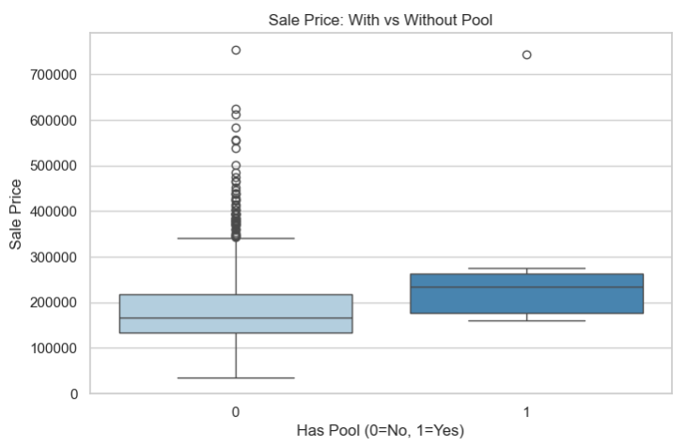
Market Trends and Historical Pricing:
# Pool presence: create binary indicator (1 if PoolArea > 0, else 0)
df_cleaned['HasPool'] = df_cleaned['PoolArea'].apply(lambda x: 1 if x > 0 else 0)
# Boxplot of SalePrice by Pool presence
plt.figure(figsize=(8,5))
sns.boxplot(x='HasPool', y='SalePrice', data=df_cleaned, palette='Blues')
plt.title('Sale Price: With vs Without Pool')
plt.xlabel('Has Pool (0=No, 1=Yes)')
plt.ylabel('Sale Price')
plt.show()

Slide 18
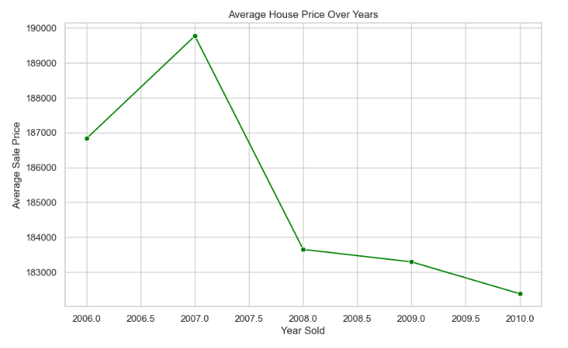
Market Trends and Historical Pricing:
# Group by Year Sold and calculate average price
yearly_price = df_cleaned.groupby('YrSold')['SalePrice'].mean().reset_index()
# Line plot for yearly price trends
plt.figure(figsize=(10,6))
sns.lineplot(data=yearly_price, x='YrSold', y='SalePrice', marker='o', color='green')
plt.title('Average House Price Over Years')
plt.xlabel('Year Sold')
plt.ylabel('Average Sale Price')
plt.show()

Slide 19
Thank You

